Slide 1
Decision Tree Algorithms
Foundation for Tree Based ML Methods

Slide 2
Contents
01
02
Introduction to Decision Tree
Decision Tree – Basic Framework
03
04
What is CART ?
Decision Tree – Basic Components
05
06
Binary and Non-Binary Decision Trees
Decision Tree Algorithms
07
07
08
ID3 Algorithm
Entropy and Information Gain
09
10
CART Algorithm
Python Functions

Slide 3
Introduction to Decision Tree
Decision Tree breaks down a data set into smaller subsets and presents association between target variable(dependent) and independent variables as a tree structure.
Final result is a tree with Decision Nodes and Leaf Nodes.
A decision node has two or more branches and leaf node represents a classification or decision.

Slide 4
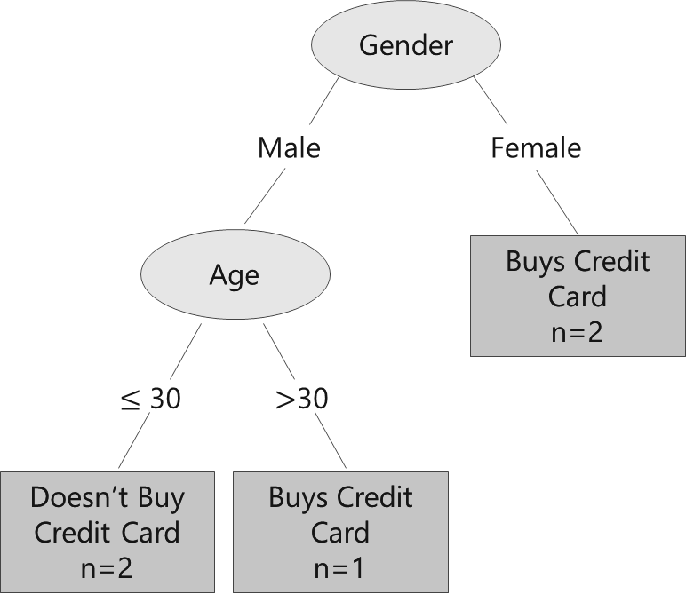
Decision Tree – Basic Framework
Suppose we have information about 5 customers and their decision about buying a credit card.
This data can be represented as a Decision Tree:
Customer no. | Gender | Age | Occupation | Buys credit card
01 | Male | ≤ 30 | Student | No
02 | Male | ≤ 30 | Professional | No
03 | Female | ≤ 30 | Business | Yes
04 | Male | > 30 | Business | Yes
05 | Female | > 30 | Professional | Yes
First subset is based on Gender. All females opt for credit card.
Males however, can be split further, based on Age. Male customer of age ≤ 30 years do not buy credit card, whereas those > 30 do buy card.

Slide 5
What is CART ?
The term Classification And Regression Tree (CART) analysis is an umbrella term used to refer to predictive decision tree procedures, first introduced by Breiman et al.
Classification Tree
When the predicted outcome is the class to which the data belongs.
In such cases, dependent variable is categorical
Independent variables can be either continuous or categorical or both
Regression Tree
When the predicted outcome can be considered a real number.
In such cases, dependent variable is continuous
Independent variables can be either continuous or categorical or both

Slide 6
Decision Tree – Basic Components
Component | Description | Alternate terms
Root node | Has no incoming edges and zero or more outgoing edges | Parent node
Internal nodes | Each has exactly one incoming edge and two or more outgoing edges | Decision nodes / Child nodes
Leaf node | Each has exactly one incoming edges and no outgoing edges | Terminal nodes
Branches | Categories of attributes | Edges

Slide 7
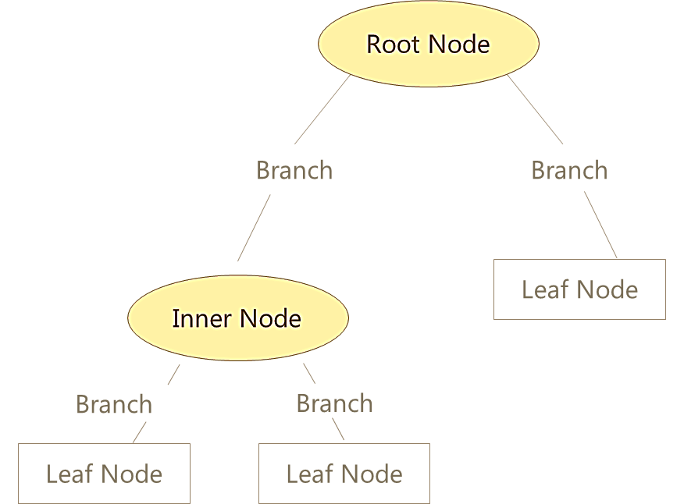
Decision Tree – Basic Components
The first variable used for separating the observations
Categories of Attribute
Next attribute for separating the observations
Class Labels
7
Class labels show observations belong to which class. The leaf node also shows Number of observations and Error rate (Actual classification vs classification given by the tree)

Slide 8
Binary and Non Binary Trees
Customer No. | Occupation | Buys credit card
01 | Student | No
02 | Professional | No
03 | Business | Yes
04 | Business | Yes
05 | Professional | Yes
Consider the same example illustrated earlier.
Occupation is the nominal attribute under consideration, with three distinct categories.
There are two ways in which a decision node can be split into further branches:
Occupation
Occupation
Student
Not a Student {Professional or Business}
Student
Business
Professional
Binary Tree
Non-Binary Tree
Binary and non-binary branches can be generated for ordinal and continuous variables as well

Slide 9
Decision Tree Algorithms
Trees used for regression and trees used for classification have some similarities - but also some differences, such as the procedure used to determine where to split.
There are many specific decision-tree algorithms. Notable ones include:
1. ID3 (Iterative Dichotomiser 3)
2. C4.5 (Successor of ID3)
3. CART (Classification And Regression Tree)
4. CHAID (CHi-squared Automatic Interaction Detector)
  Performs multi-level splits when computing classification trees
5. MARS (Multivariate Adaptive Regression Splines)
  Extends decision trees to handle numerical data better
6. Conditional Inference Trees
  Statistics-based approach that uses non-parametric tests as splitting criteria, corrected for multiple testing to avoid overfitting. This approach results in unbiased predictor selection and does not require pruning

Slide 10
ID3 Algorithm
The ID3 (Iterative Dichotomiser 3) algorithm, developed by J.R. Quinlan, builds a classification decision tree using a top-down, greedy approach.
High-Level Procedure
Calculate Information Gain for all attributes
Select attribute with maximum Gain and split the data
Repeat the process recursively for each subset until stopping criteria are met
Being greedy, it chooses the best split locally at each stage without backtracking.
In order to decide which attribute should be included in the decision node, ID3 uses Entropy and Information Gain
Identify the Best Attribute
Split the Data Set into Subsets
Make a Decision Tree Node
Recursively Make New Decision Tree Nodes

Slide 11

Concept of Entropy
Entropy measures the homogeneity of a sample. It is used as a parameter for checking the amount of uncertainty associated with a set of probabilities.
Entropy lies between 0 and 1 for binary classification problem
If the sample is completely homogeneous the entropy is 0 and if the sample is equally divided it has entropy of 1
Entropy can be of two types, for each category and at the variable level
Entropy of a category is calculated as:
Where P1 is the proportion of class 1 and P2 is the proportion of class 2

Slide 12
Entropy of a Category
Let us consider survey data from three cities depicting shopper’s preferred brand
Entropy for each city is calculated as:
Manchester: – 0.225 * log₂ (0.225) – 0.775 * log₂ (0.775) = 0.76919
Birmingham: – 0.1 * log₂ (0.1) – 0.9 * log₂ (0.9) = 0.46900
London: – 0.5 * log₂ (0.5) – 0.5 * log₂ (0.5) = 1
City | Brand A Voters | Brand B Voters | Number of Voters | % of votes for Brand A | % of votes for Brand B
Manchester | 90 | 310 | 400 | 22.5% | 77.5%
Birmingham | 10 | 90 | 100 | 10% | 90%
London | 100 | 100 | 200 | 50% | 50%
Entropy at the Variable Level
Entropy at the variable level can be derived by adding weighted averages of all category level entropy values
Weights are the proportion of respondents in each category (here in each city)
In the example under consideration, weights for the categories are
Manchester: 400/700 = 0.5714 Birmingham: 100/700 = 0.1428 London: 200/700 = 0.2857
Entropy at the variable level is 0.57 * 0.76919 + 0.14 * 0.46900 + 0.29 * 1 = 0.79225

Slide 13
Concept of Information Gain
Information Gain is based on the decrease in entropy after a dataset is split on an attribute
Constructing a decision tree is about finding attribute that returns the highest information gain
Information Gain =
Entropy of sample (Dependent Variable)
– Average Entropy of Any of the Independent Variable
Information gain can be interpreted as ability of reducing the uncertainty (Entropy) and hence increase predictability

Slide 14
Calculation of Information Gain
City | Brand A Voters | Brand B Voters | Number of Voters | % of votes for Brand A | % of votes for Brand B
Manchester | 90 | 310 | 400 | 22.5% | 77.5%
Birmingham | 10 | 90 | 100 | 10% | 90%
London | 100 | 100 | 200 | 50% | 50%
Entropy for complete sample is calculated as follows:
P1 = (Total Brand A Voters / Total Voters)
P2 = (Total Brand B Voters / Total Voters)
Entropy=−(0.286)∗log⁡₂(0.286)−(0.714)∗log⁡₂(0.714)=0.86312
Information Gain: 0.86312−0.79225=0.070868

Slide 15
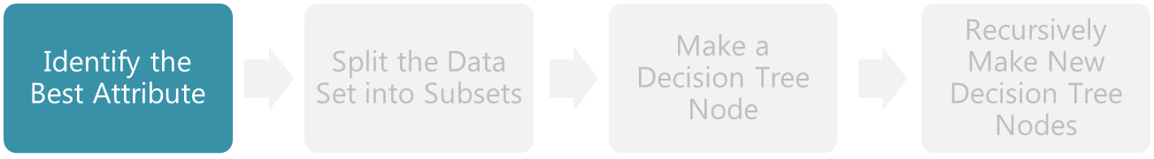
Information Gain and ID3 Algorithm
Let us now go back to the basic ID3 algorithm; Step 1 of which is ‘Identify the Best Attribute’
Information Gain value is used to determine which attribute is the “best” – the attribute with most information gain is chosen
Information gain for a variable is high when that variable has the low entropy at the variable level (Weighted average)
Low entropy for a variable implies the classification based on that attribute is fairly homogenous , hence this attribute is selected as the first best attribute
The same process is repeated till all attributes are used as split variables

Slide 16
CART Algorithm
The Classification and Regression Tree (CART) algorithm constructs a binary decision tree by repeatedly splitting nodes into two branches.
The root node contains the entire training dataset, and each node split is univariate, meaning it is determined using the value of a single predictor variable.
The algorithm proceeds through the following key steps:
Select the optimal feature and split point.
Divide the dataset into two subgroups based on the split.
Recursively repeat the splitting process until a stopping rule is reached.
For different types of prediction tasks, CART uses different splitting criteria:
Classification problems: typically use Gini impurity to evaluate splits.
Regression problems: typically use Mean Squared Error (MSE) to evaluate splits.
Identify Each Predictor’s Best Split
Find the Node’s Best Split
Split the Node

Slide 17
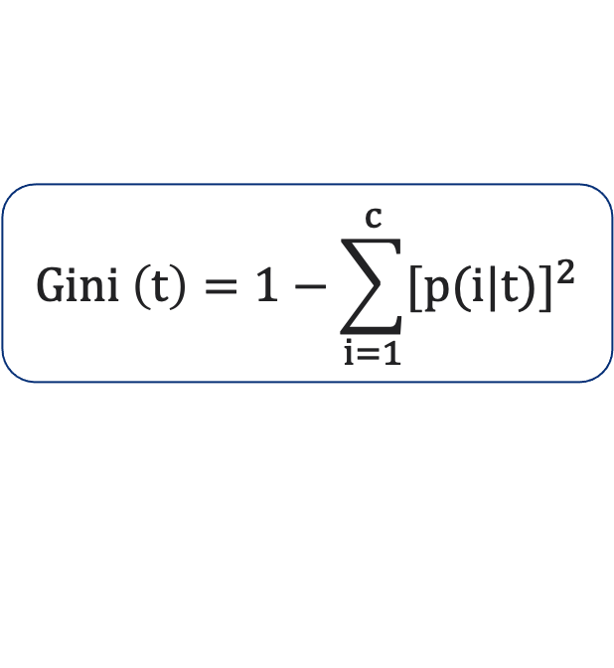
Gini Impurity
Gini Impurity is a measure of how often a randomly chosen element from the set would be incorrectly labeled if it was randomly labeled according to the distribution of labels in the subset
      where
      p(i|t) : Fraction of records belonging to class i at node t
It reaches its minimum (zero) when all cases in the node fall into a single target category
Attribute with the smaller Gini Impurity is considered for the split

Slide 18
Python: Classification Tree Using Information Gain
# Classification Tree Using Information Gain
dtcl = DecisionTreeClassifier(criterion='entropy',
min_samples_split= int(len(X_train)*.10))
dtcl.fit(X_train, y_train)
DecisionTreeClassifier() from sklearn.tree fits a classification tree.
criterion= ‘entropy’ specifies the function to measure the split. Default is ‘gini’ for Gini impurity. ‘entropy’ stands for information gain.
min_samples_split= minimum number of samples required to split an internal node. This number is set to be 10% of the sample size.
The output displays model specifications.

Slide 19
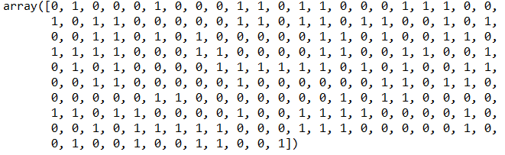
Classification Tree in Python – Prediction
# Generating Predictions for the model
y_pred = dtcl.predict(X_test)
y_pred_probs = dtcl.predict_proba(X_test)
cutoff = 0.3
pred_test = np.where(y_pred_probs[:,1] > cutoff, 1, 0)
pred_test
# Output

Slide 20
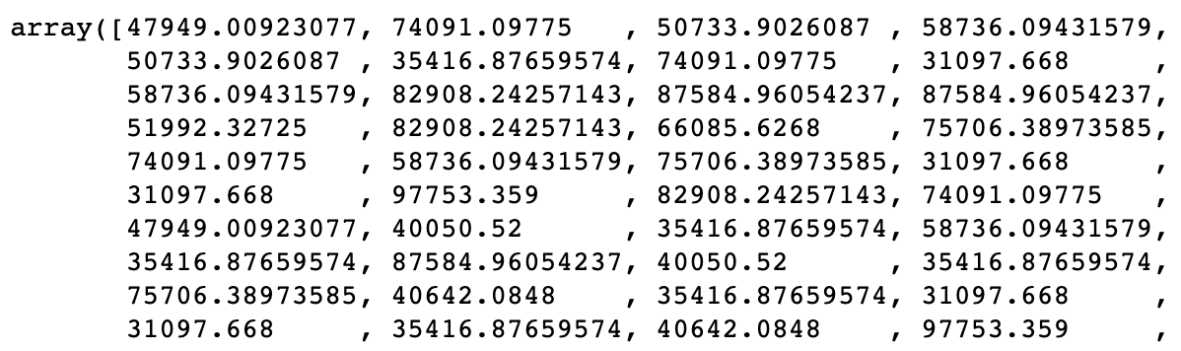
Regression Tree in Python
# Regression Tree Using MSE
dtreg = DecisionTreeRegressor(min_samples_split =
int(len(X_train)*.10))
dtreg.fit(X_train, y_train)
# Predictions
y_pred_reg = dtreg.predict(X_test)
y_pred_reg
# Output
DecisionTreeRegressor() from sklearn.tree fits a regression tree.
min_samples_split= minimum number of samples required to split an internal node. This number is set to be 10% of the sample size.
The output displays model specifications.
predict() returns predicted regression value for X. Output is an array.

Slide 21
Key Takeaways: Decision Tree Algorithms
Foundation of Tree-Based Methods
Decision trees break down datasets into smaller subsets, creating a hierarchical structure with decision nodes and leaf nodes. They form the basis for powerful ensemble methods and handle both classification and regression tasks.
Splitting Criteria Drive Performance
Entropy measures uncertainty (0 to 1 scale), while information gain quantifies uncertainty reduction. Gini impurity evaluates split quality by measuring classification error probability at each node.
Two Major Algorithm Families
ID3 uses entropy and information gain to select optimal splits, choosing attributes that maximize predictability. CART creates binary trees using Gini impurity for classification and MSE for regression.
Python Implementation
Use DecisionTreeClassifier() with criterion='entropy' or 'gini', and DecisionTreeRegressor() for continuous outcomes. Set min_samples_split to control tree complexity and prevent overfitting.

